Slide 1

Cloud Native Architecture
Yadhav Jayaraman

Slide 2


WE BELIEVE
Competitive advantage or innovative cost reduction can only come from custom built software, not packaged applications.
Notes:
At Pivotal, we believe Transforming how the world builds software will shape the future.
This is our core guiding principle that shapes our product and corporate strategy
With modern, cloud native development techniques, building software custom is faster than buy and customize.

Slide 3
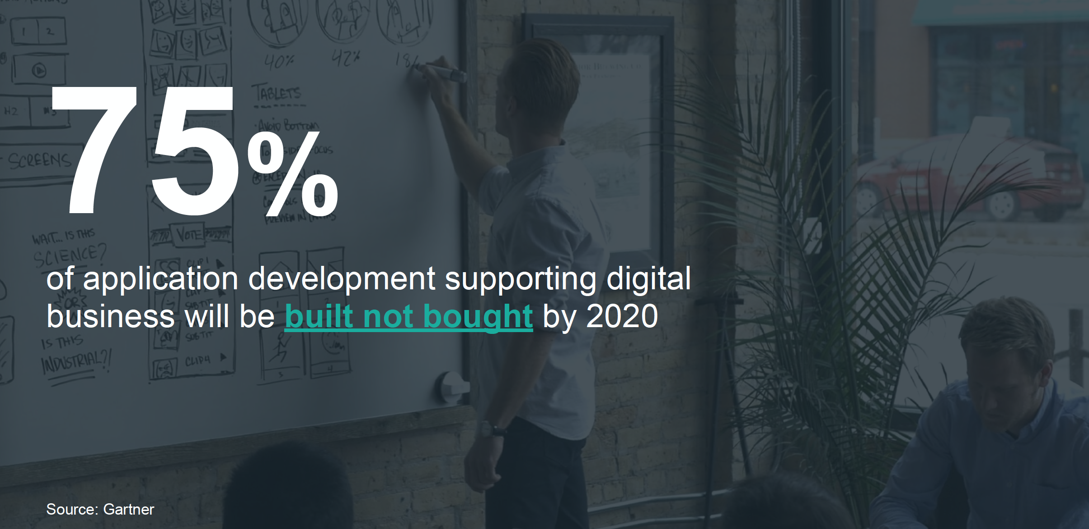

Slide 4



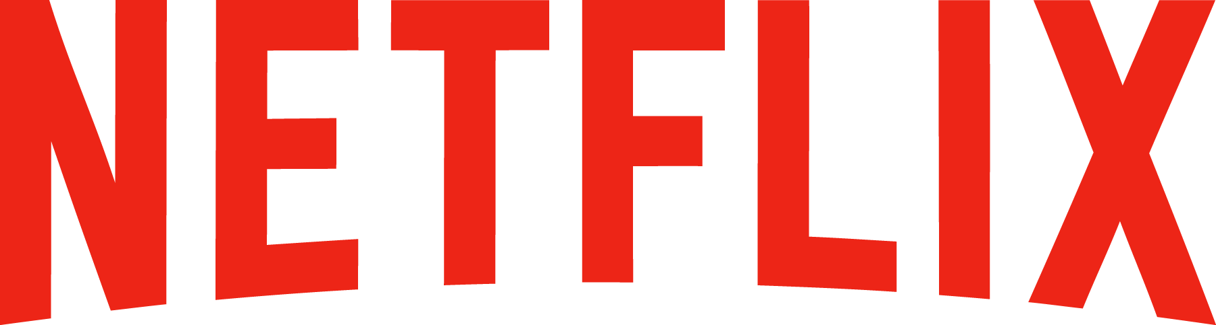








Software is changing INDUSTRIES
$313.9BN
Retail
$2.11BN
Retail
$53BN
Entertainment
Bankrupt
Entertainment
$26BN
Hotel
$6.88BN
Hotel
$34BN
Automotive
$56/57BN
Automotive
$50BN
Transportation
$191M
Transportation
$3.2BN
Industrial Products
$80.11BN
Industrial Products
Medallion
Financial
Notes:
Now, you might have seen some version of the story where several Silicon Valley companies are disrupting traditional industries and creating tremendous value.
Uber has no cars, AirBnB owns no real estate, Facebook doesn’t generate content and Amazon has no retail stores. This is all based on software. And that’s really a great story.

Slide 5
tl;dr
you are building a software company
or losing to someone who is

Slide 6
tl;dr
you are continuously delivering microservices
or losing to someone who is

Slide 7



Cloud native and microservice models are moving into the Fortune 500
“I said to my vendors, I don’t want five years ago. I want five years from now.
“Two people built an app and got it into the App Store in five weeks”
“The adopters we speak to today, like GE, HP, Equinix, PayPal, Capital One, Goldman Sachs, Airbnb, Medallia, Square, and Xoom say that microservices are well worth the tradeoffs.”
Notes:
PCF is the 1st and only cloud native vendor at the moment
Source: WSJ http://blogs.wsj.com/cio/2015/10/05/innovate-or-die-the-rise-of-microservices/
Antonio Melo, Humana, CF Summit 2015

Slide 8

Becoming Cloud Native
Notes:
How does one become cloud native and what does it mean ? - lets dig deeper

Slide 9
Software developers spend too much time NOT writing software
Design and Coding
Brainstorming
Administrative tasks
Managing Environments
Waiting for Test/Build
Average Hours/Week
Sources: “Electric Cloud LinkedIn Survey to software developers”
Notes:
And here’s the reality.
You have a precious resource that’s spending TOO much of their time, not doing what you hired them to do. And for good reason.

Slide 10
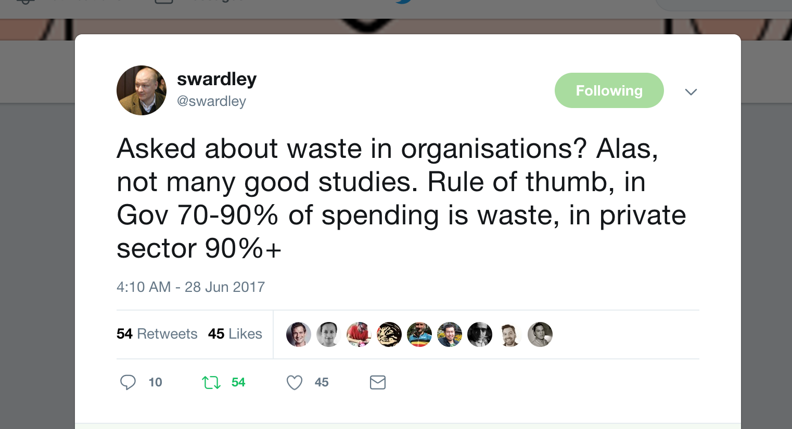
Organizations are notoriously inefficient in delivering value

Slide 11
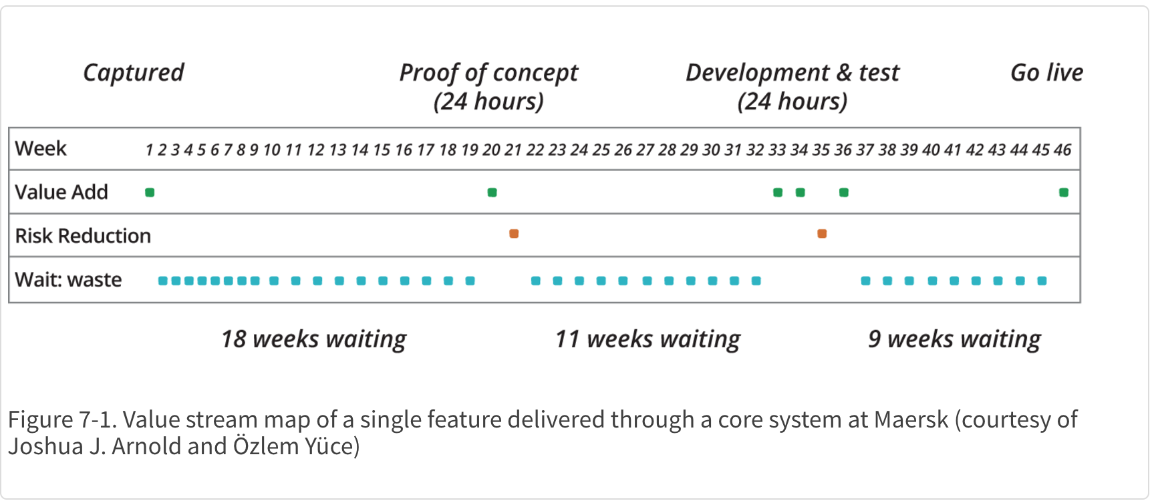
There is a lot of waiting in Enterprise IT processes

Slide 12
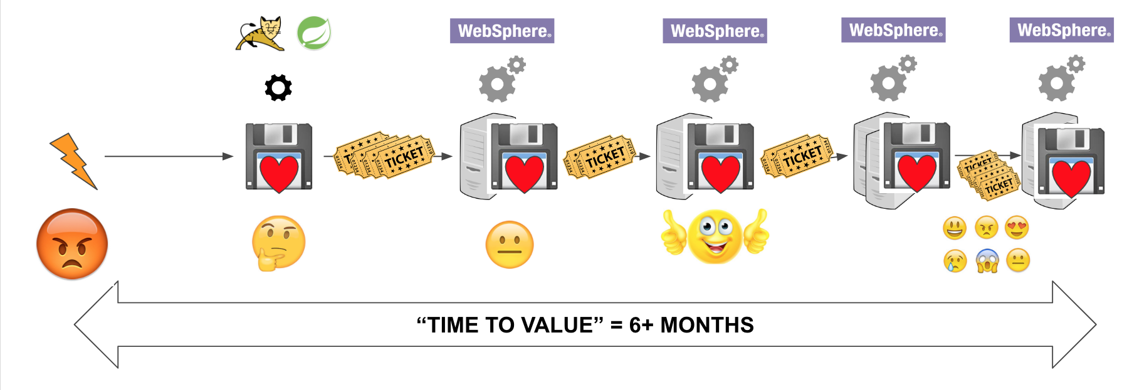
There is a lot of ticketing in Enterprise IT processes

Slide 13
Complexity
Notes:
Spring Boot is bringing productivity of dynamic languages like Ruby on Rails, Perl, PHP and more to the Java 6,7, and 8. This means that enterprises no longer need to sacrifice the stability, performance, concurrency, and type safety of Java to get better developer productivity – they can have the best of both worlds.

Slide 14

Spring Boot
Dynamic language productivity with maturity of enterprise Java
Cloud Native: Direct support for Microservices, NetflixOSS++
Fully automated app server configuration and deployment
Production ready Ops metrics out of the box, with a switch
Notes:
Why is boot so successful with developers? It doesn’t try to address concerns like reliability, availability, scalability, performance, and lets the platform it runs on handle it, focusing instead on developer productivity 100%. The Application Server technology of the last decade failed when trying to address these concerns at the Java container level, for internet scale.
Improvement in developer productivity: Boot has been created with a singular focus - Make developers productive, they focus on core business logic, Boot does all the rest of the heavy lifting. For ex: A dev can now write a robust database connected rest service in 10s of lines of code.
Ease of deployability: Spring Boot apps can be deployed in a few minutes with an embedded web runtime to lower the sprawl (and cost) of app servers.
So developers and operators both see benefits of building their apps on Spring Boot. 100% of Spring Boot codebase remains in the open source like all Spring projects.

Slide 15


Innovation Speed in Java WINS
“Velocity on the JVM is the Killer App”
Andy Glover (Netflix Cloud Ops) @ SpringOne2GX 2014 Keynote – Early Spring Boot adopters
Youtube Link to Video
Notes:
Java is the #1 programming language today, but it’s been traditionally been more difficult to develop at earlier stages of an application’s lifecycle vs. dynamic languages like Ruby, PHP, Python etc. After trying Ruby and Node.js, Netflix realized they needed the performance, stability, concurrency of the JVM for their application to service an exploding level of traffic, but was having trouble finding the right RAD capability to give them the development velocity they wanted.

Slide 16
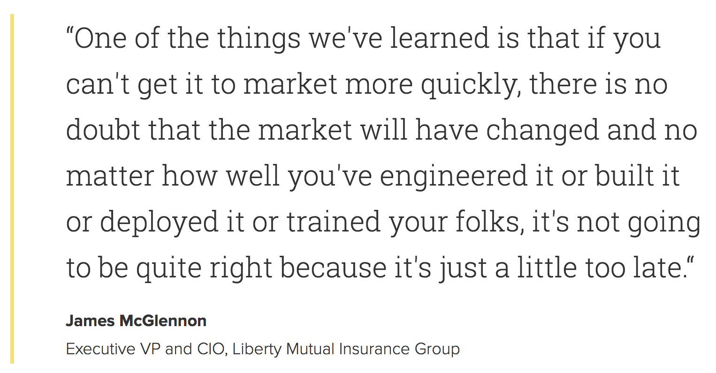
Time is of the essence

Slide 17
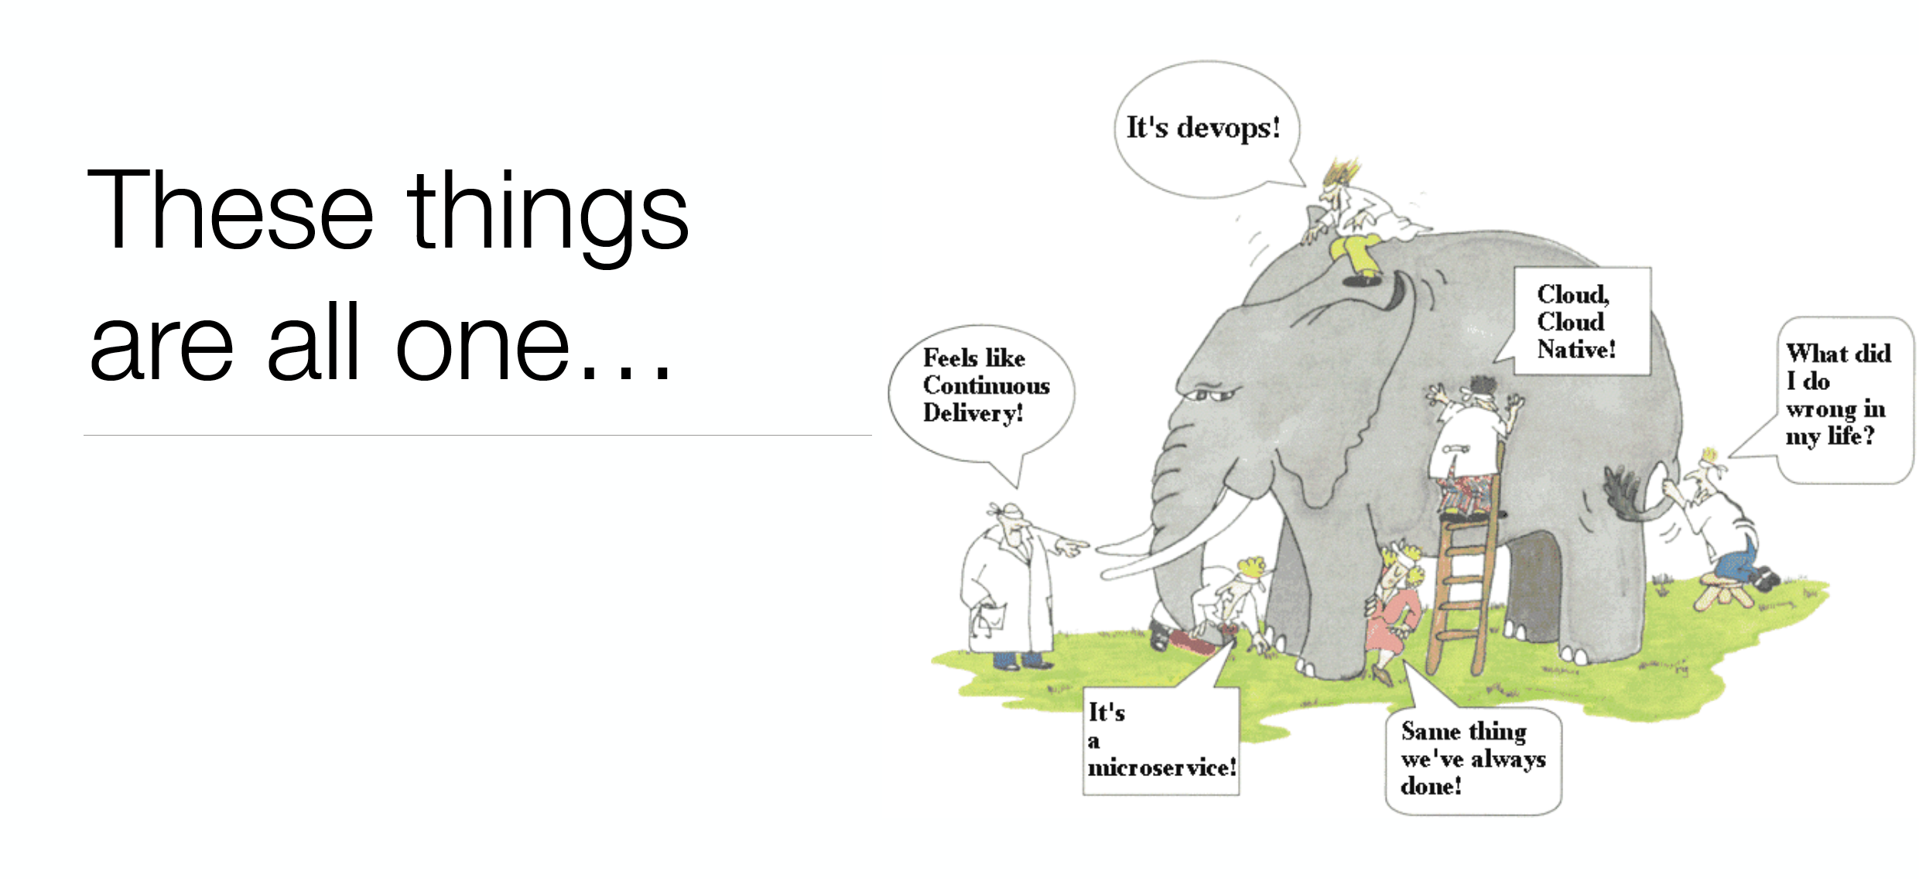

Slide 18
I am going to call it all together…
‘Cloud Native’

Slide 19
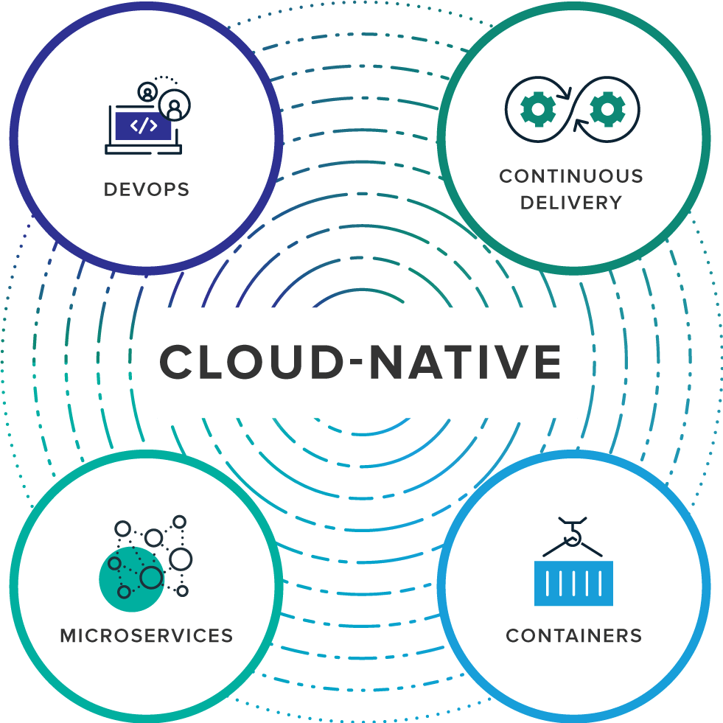
What is Cloud Native?
Notes:
Cloud-native is an approach to building and running applications that fully exploits the advantages of the cloud computing delivery model. Cloud-native is about how applications are created and deployed, not where. While today public cloud impacts the thinking about infrastructure investment for virtually every industry, a cloud-like delivery model isn’t exclusive to public environments. It's appropriate for both public and private clouds. Most important is the ability to offer nearly limitless computing power, on-demand, along with modern data and application services for developers. When companies build and operate applications in a cloud-native fashion, they bring new ideas to market faster and respond sooner to customer demands.
Organizations require a platform for building and operating cloud-native applications and services that automates and integrates the concepts of DevOps, continuous delivery, microservices, and containers:

Slide 20
Key Terms
DevOps is the collaboration between software developers and IT operations with the goal of constantly delivering high-quality software that solves customer challenges. It creates a culture and environment where building, testing and releasing software happens rapidly, frequently, and more consistently.
Continuous Delivery, enabled by Agile product development practices, is all about shipping small batches of software to production constantly, through automation.

Slide 21
Key Terms
Microservices is an architectural approach to developing an application as a collection of small services; each service implements business capabilities, runs in its own process and communicates via HTTP APIs or messaging. Each microservice can be deployed, upgraded, scaled, and restarted independent of other services in the application, typically as part of an automated system, enabling frequent updates to live applications without impacting end customers.
Containers offer both efficiency and speed compared with standard virtual machines (VMs). Using operating system (OS)-level virtualization, a single OS instance is dynamically divided among one or more isolated containers, each with a unique writable file system and resource quota. The low overhead of creating and destroying containers combined with the high packing density in a single VM makes containers an ideal compute vehicle for deploying individual microservices.

Slide 22
A bookstore in Seattle, deploys
code to production every 11 seconds…

Slide 23
A bookstore in Seattle, deploys
code to production every 11 seconds…

Slide 24
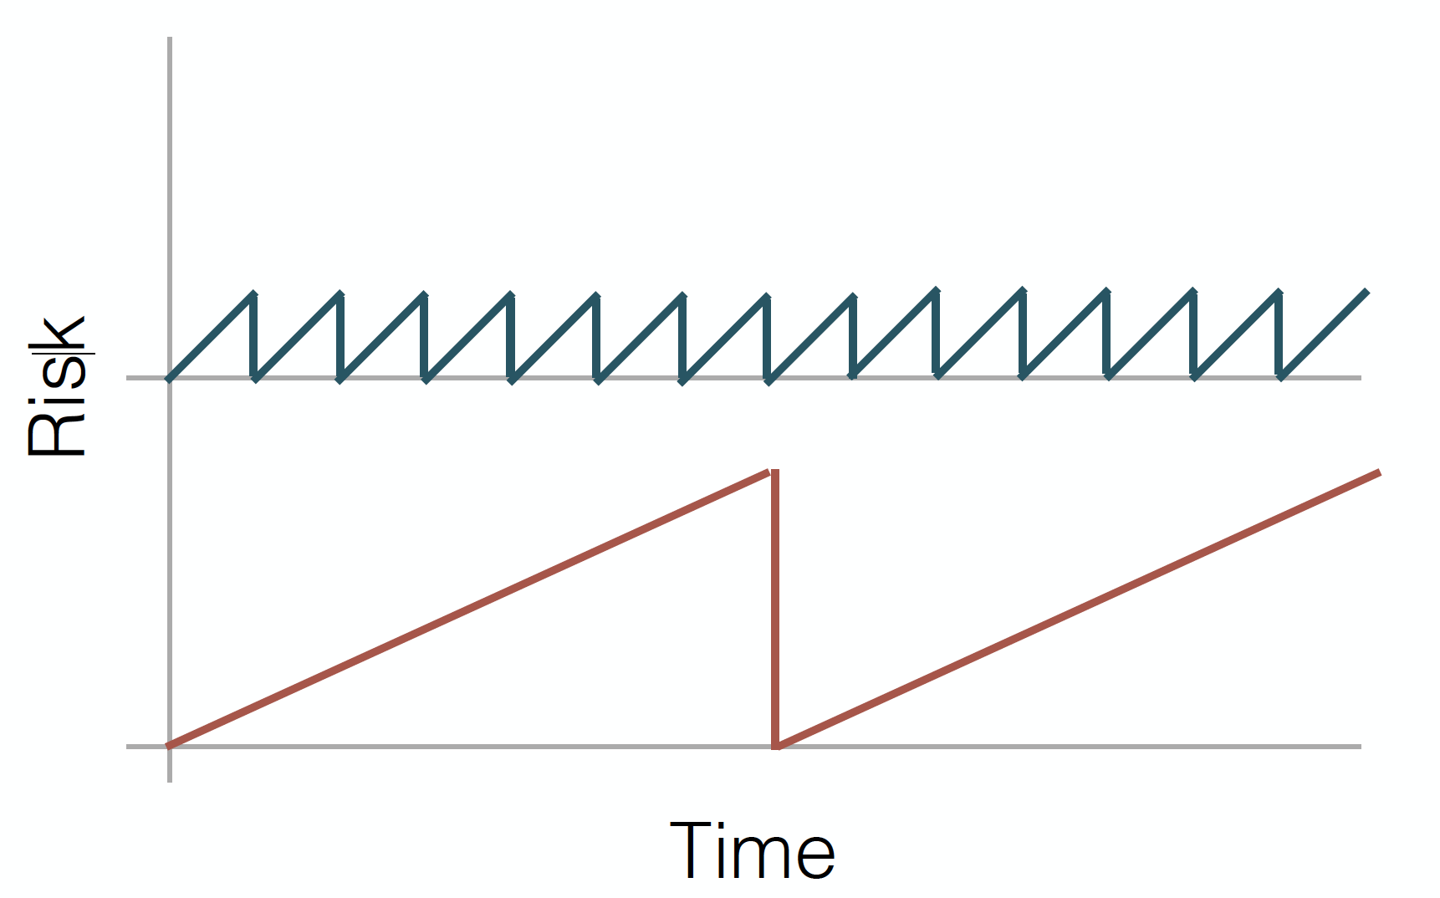

Slide 25
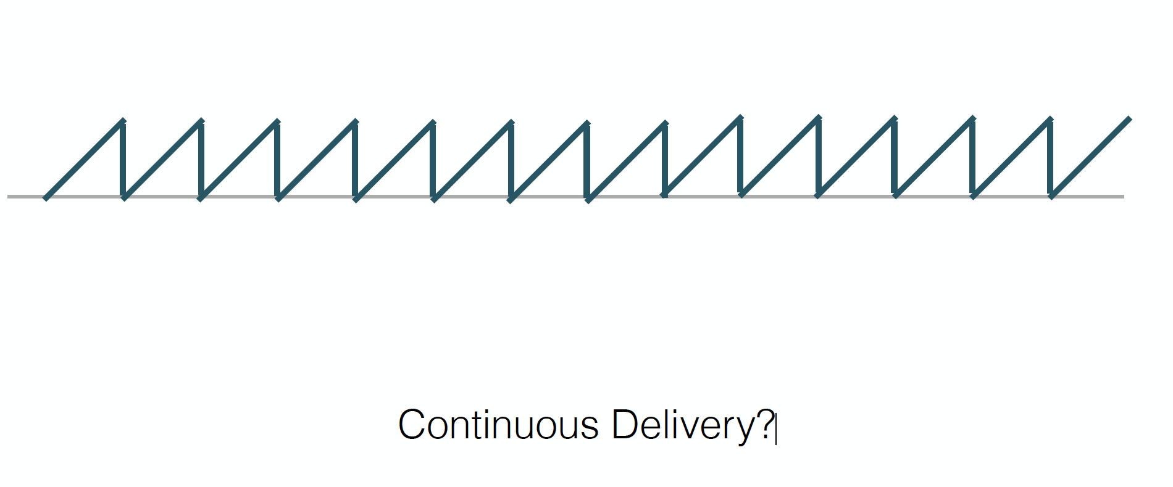

Slide 26


Slide 27
The goal of a startup is to figure out the right thing to build— the thing customers want and will pay for— as quickly as possible
- Eric Ries, The Lean Startup

Slide 28
Focus on doing one thing well…
Decouple your code from external depedencies/risks…
That is a micro service

Slide 29
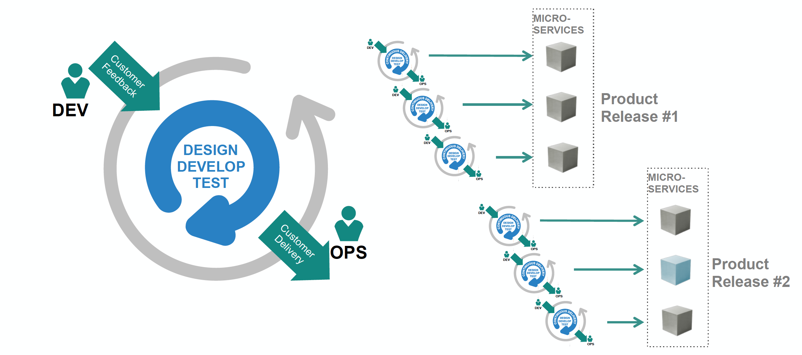
Rise of the cloud natives

Slide 30


Monolithic Architecture: Ripe for Disruption
Many apps start as monoliths
..and get redesigned when
they start to achieve real success
Microservice
(distributed)
User Adoption
Monolithic
Redesign!
Scale of development team / org
http://www.infoq.com/interviews/adrian-cockcroft-microservices-devops
Notes:
Acknowledged as a good way to start
Inefficient / Expensive Scaling
Difficult to optimize single container for multiple applications
$$$ to scale up
Difficult to move to the cloud (in the case of monolithic appserver)
Change Cycles Tightly Coupled / Obstacle to Frequent Deploys
Can Be Intimidating to New Developers
Obstacle to scaling the size of the development team
Any change implies re-testing of the whole monolith, creating barrier
Complex, centralized governance models tend to fail in large organizations
PaaS can run monolithic (12factor) apps as well as uServices

Slide 31




monolith
User
Interface
Like
Photos
Compose Message
Message
Message Notification
Attach a picture
Deployable Unit
Entire team must collaborate into this one unit
Notes:
Whole app is one thing.

Slide 32
microservice
Like
User
Interface
Deployable Unit #2
Deployable Unit #5,6,7
Photos
Compose Message
Deployable Unit #3
Message
Message Notification
Deployable Unit #1
Deployable Unit #4
Attach a picture
Reorg into smaller teams aligned to features
Notes:
Development and DevOps teams can work more independently on microservice style applications, and coupled with the right culture and processes, it fosters a number of desirable traits:
Development Speed, Parallelism in dev efforts
Finer grained operational control – manage / scale just components of the app that require attention
Scalability
Resiliency
Fault tolerance
Graceful degradation
Smaller codebases easier to learn and maintain
Less interdependence makes adding new feature/capability less scary, no need to retest the entire monolith for a given change

Slide 33
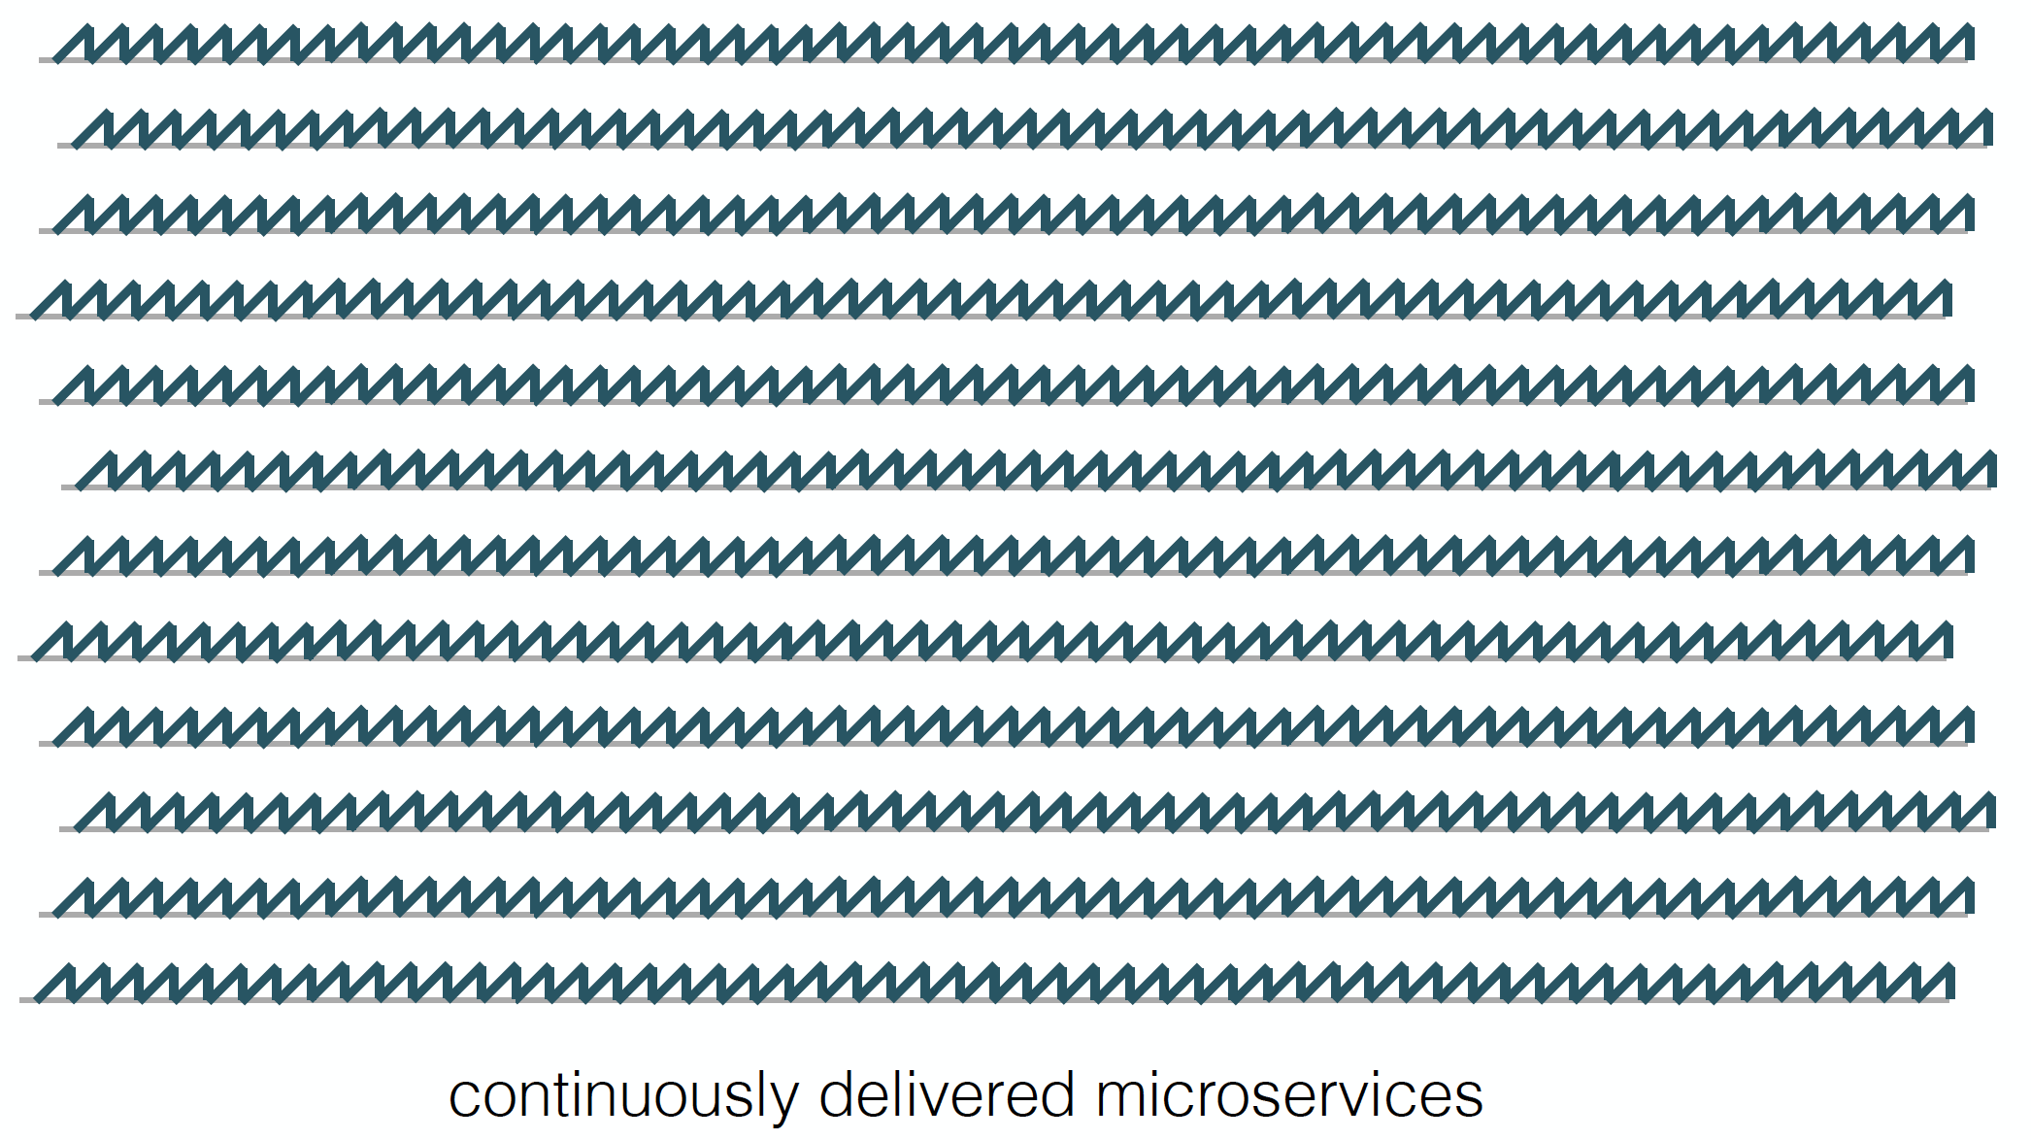

Slide 34
Continously deployed microservices means more things to manage

Slide 35
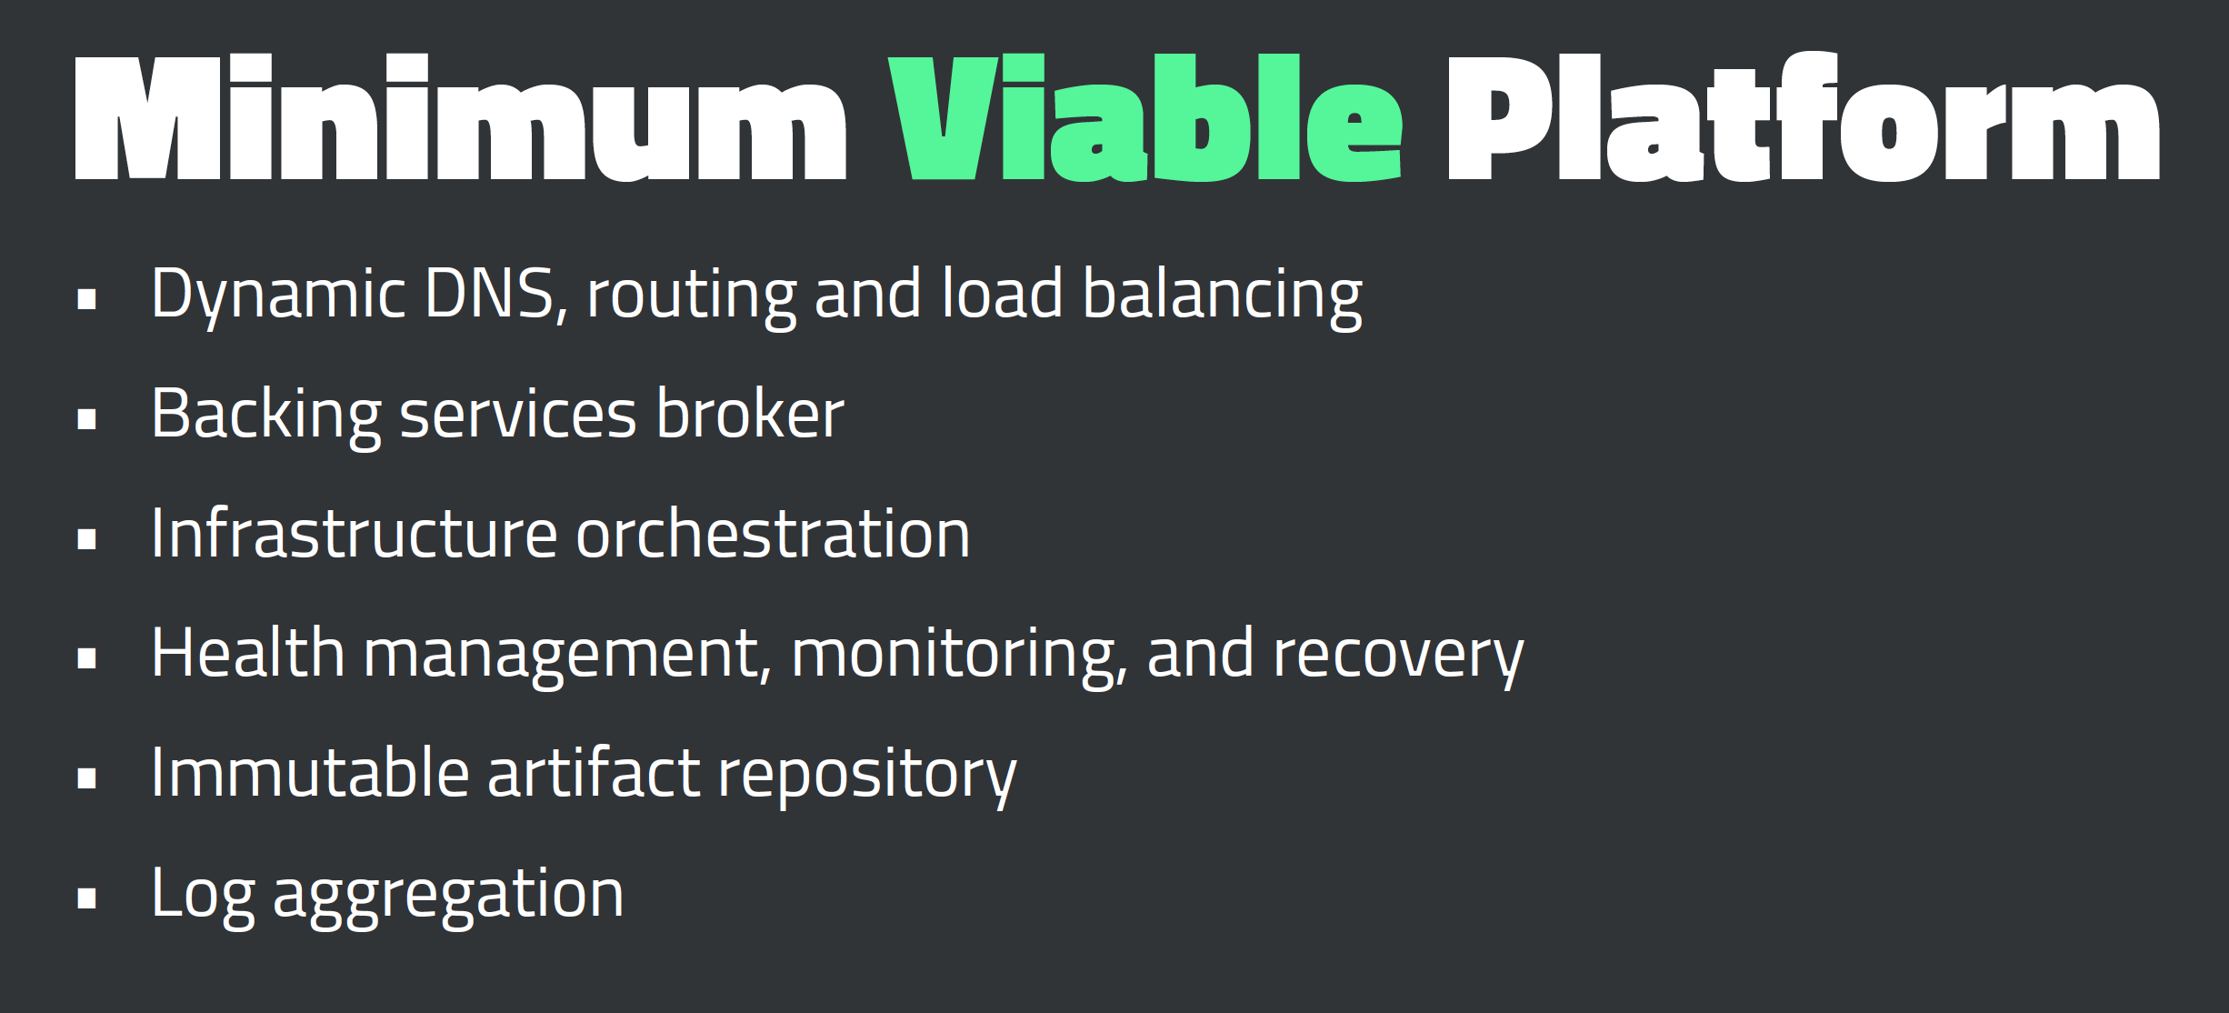

Slide 36


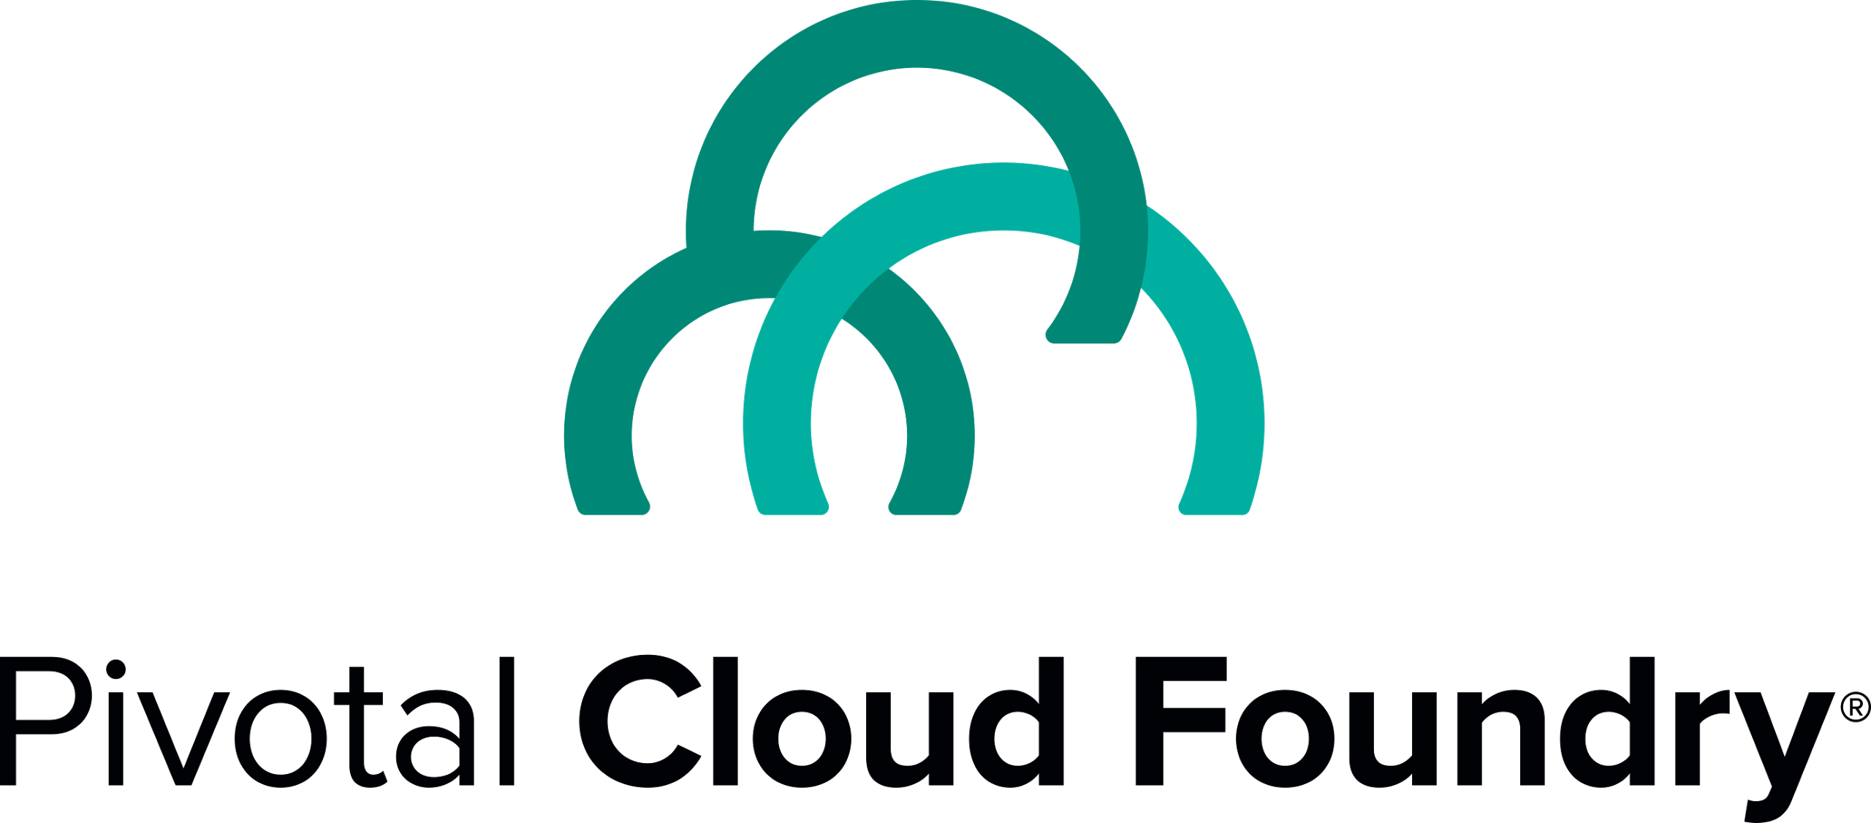

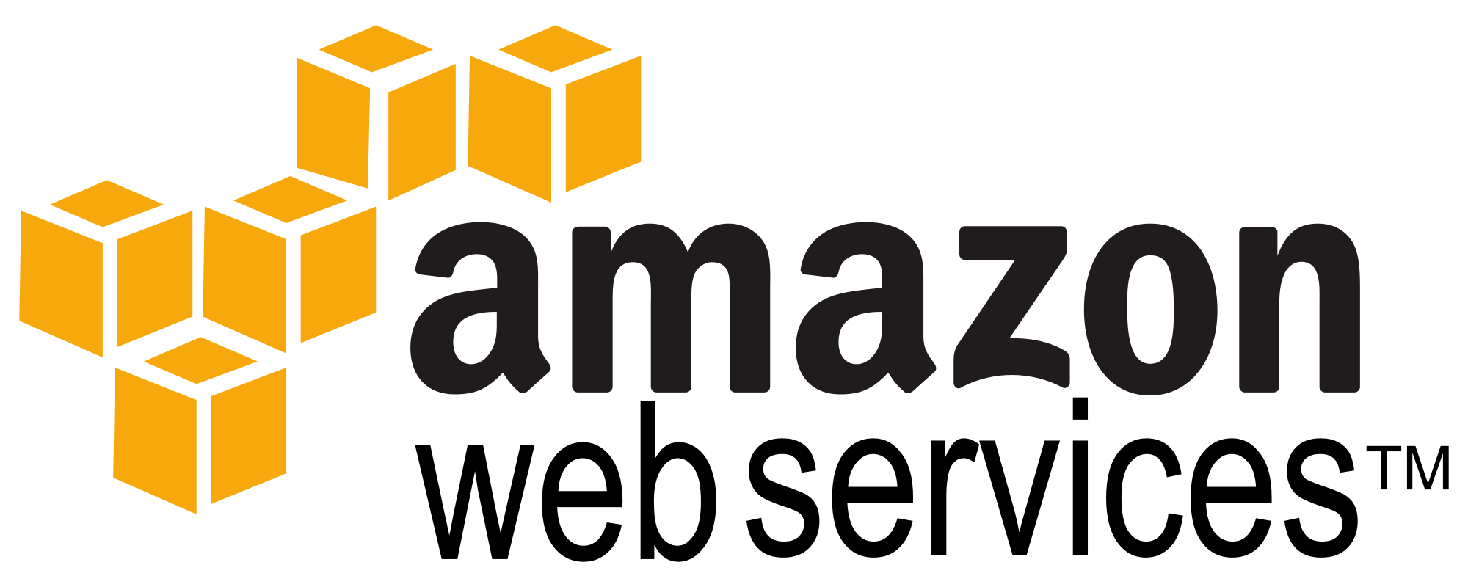
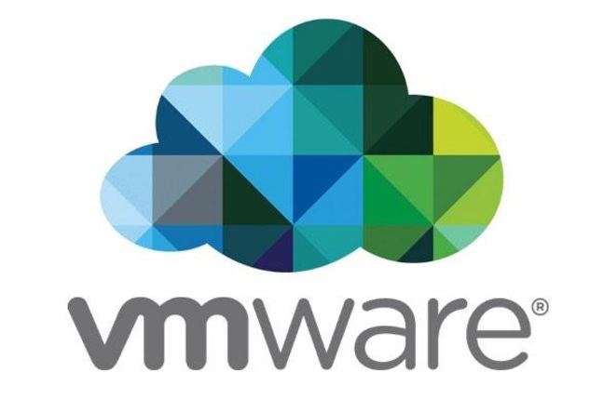

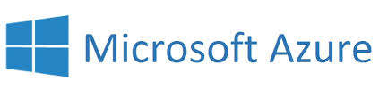
Culture
Cloud Native Framework
Tools
Application Framework
Spring Cloud
Spring Boot
Dev
Runtime Platform
Dev
IT Ops
Infrastructure Automation
BOSH.IO
IT Ops
Infrastructure
IT Ops
AWS
VMWare
OpenStack
Azure
Notes:
Pivotal breaks down cloud native technology into 3 layers, which is all supported, reinforced and optimized by cloud native culture and Tools. The Application Framework is what’s used to implement 12-Factor designs, that will work on cloud-native runtimes and infrastructure automation. Pivotal is the 1st and only vendor to integrate microservices from end-to-end: from the app dev stack, to the cloud platform, and the underlying infrastructure automation.
Let’s lets talk a little more about Developers

Slide 37
The developer dream haiku
Here is my source code,
Run it in the Cloud for me,
I do not care how
Notes:
An important and in-demand resource these days – Your developers. This is what they really want, but can be afraid to trust.

Slide 38
Culture
Cloud Native Framework
Tools
Application Framework
Spring Cloud
Spring Boot
Dev
Runtime Platform
Dev
IT Ops
Infrastructure Automation
BOSH.IO
IT Ops
Infrastructure
IT Ops
AWS
VMWare
OpenStack
Azure
Notes:
Pivotal breaks down cloud native technology into 3 layers, which is all supported, reinforced and optimized by cloud native culture and Tools. The Application Framework is what’s used to implement 12-Factor designs, that will work on cloud-native runtimes and infrastructure automation.
This may seem a lot to take initially, so lets break it down later by layer.
Starting at the top - But before we do, lets talk about Developers

Slide 39

Application Framework
Spring Cloud
Spring Boot
Dev
Spring Boot
Spring Cloud
From 0 to app in < 5 min
Enterprise Java with dynamic language productivity
Designed for fragile infrastructure in partnership with Netflix
Java Microservice Framework
100% Spring Boot enabled
Notes:
This month alone, there were over 1.6m downloads, 8m YTD, growing at 10% m/o/m key new projects. Why? because developers love Boot - It’s zero config, super lightweight, runtime ideal for single purpose single process applications aka microservices. With Boot you can go from 0 to app in <5minutes
But remember the concept of fragile infrastructure and designing for failure? How do you wire up all these little processes into a cohesive app that works even when things go wrong?
Luckily Netflix has solved some of these problems at web scale ( their OSS stack is great, but not so easy to use). So we took that core functionality and built spring cloud. All the power of eureka, hysterix, and config server built as spring modules. As easy adding an annotation and secure for the enterprise
So awesome even netflix is using it now now in production, even building some of their own internal frameworks atop Spring Boot technology. we have the app devs able to run super fast and make lots of microservices and tie them together to make amazing apps with spring boot and cloud

Slide 40
Then
Now
Java was verbose, complex
Dynamic language productivity
Manual, SOAP based SOA
Dynamic, REST microservices
App server sprawl, manual
Autoconfig & embed app server
Complex Ops, Admin, Manage
Prod Ops features with a switch
Low productivity for
development and ops
High productivity shared DevOps responsibility
Notes:
Discovery: huge issue: mostly custom solutions, JNDI, etc.
Configuration: manual, error-prone, required app restarts
Dependencies & Resilience: co-bundling, EJBs, complex
Operators: no standardized process for deployment and management
Developers: low productivity due to complex environments and expensive context switching
Discovering by name was hard -> service registry from vendor, or use proprietary registry embedded in app server (not portable)
Config – hard to track, because not cleanly isolated, changes sneak in from development to testing to production
Dependencies – microservice bundling means independent pieces can be managed / scale independently
Operators – lots of proprietary or home grown solutions. Real silos, institutional knowledge.
Developers – fix bug for this version of JVM, scripts and exact requirements for each environment → no immutable infrastructure.

Slide 41
Spring Boot Adoption
Monthly Maven downloads only (no jCenter)
22.2M
Source: oss.sonatype.org + spring powered data quality filtering. (e.g. removing our own downloads).
Notes:
March 2017 data unavailable from Sonatype.
For reference, Eclipse downloads hold pretty steady at 1M/month in 2017.
http://www.eclipse.org/membership/slides.pdf slide 20 shows eclipse downloads but it appears they are reporting page views on the download page, which is subject to bot traffic I would think?
Here are some observations and info behind the numbers:
Simply put, we are looking for trends and the absolute number is of less value.
Download numbers are Maven Central numbers only
JCenter stats are not included. Gradle users commonly use the JCenter repository (not Maven Central) and we do not combine those downloads with Maven Central (this is by design as there are a few challenges with those stats).
Spring builds are generally excluded from the published stats as the Spring team builds against a local Spring repo
Most enterprises that are using CI are also resolving artifacts locally using Artifactory, etc. In fact, it's a fairly common enterprise practice, that developers can only download artifacts staged in their "local" repository and developers are prohibited from directly downloading from Maven Central.
So in some cases, we penalize ourselves by excluding large sources of downloads (repo.spring.io and JCenter) and don't try to estimate the implications of "local" enterprise maven repositories. On the flip side, I'm sure we benefit from automated builds but I think this number is not quite as large as I once thought.

Slide 42
The future…is here
DevOps
Spring Boot
Modern Software
Talent shortage
25% of Global 2000
>22M downloads/month
Cloud Native
Continuous Innovation
Notes:
In conclusion,
Cloud native is here - Its not iphone version 1, its not hipster software
We see massive adoption with large enterprise
Trends show –
DevOps
SpringBoot
Software
Talent shortage

Slide 43
Q&A

